Slide 1
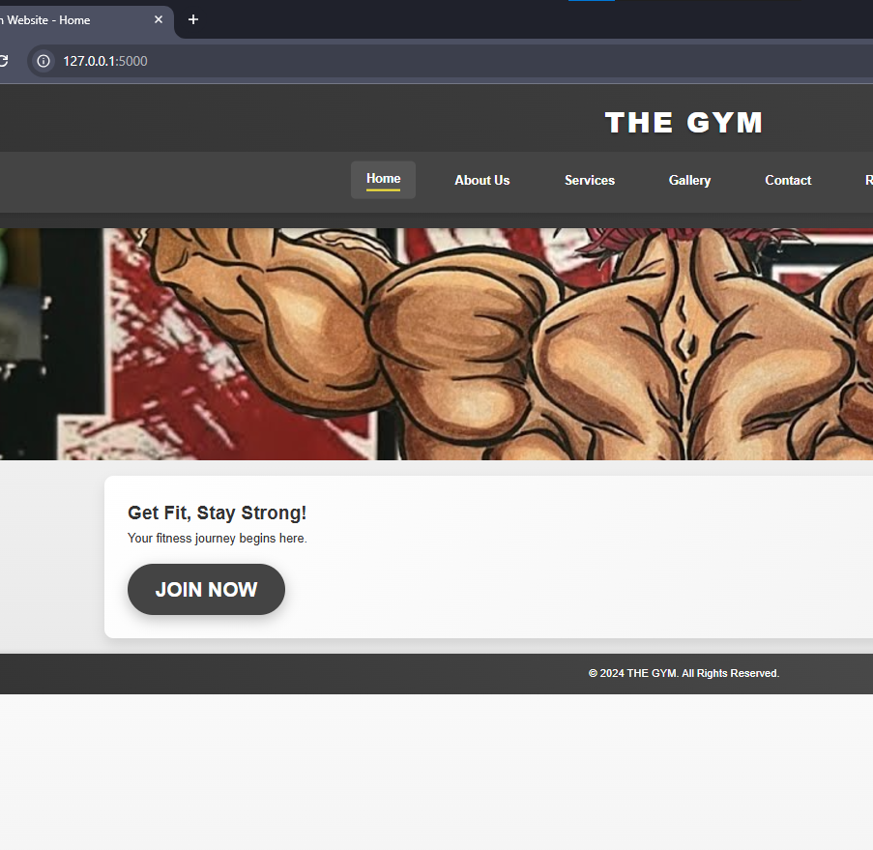
The Gym Website – A Flask-Based Web Application
Project Presentation
By Mukhdoom Hammad Khan

Slide 2
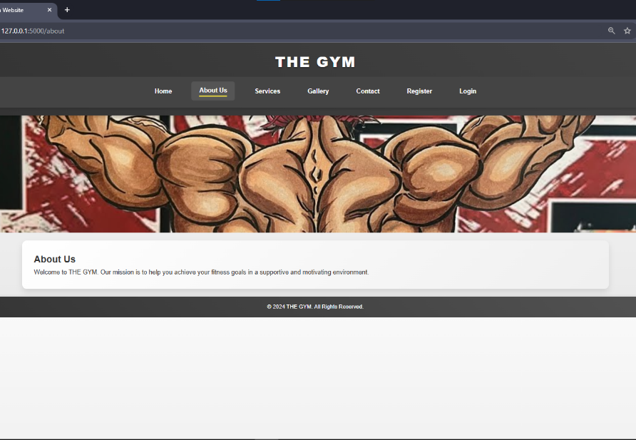
Purpose of the Website
Purpose:
- Provide information about the gym.
- Allow users to explore services.
- Simulate login and registration for users.

Slide 3
Folder Structure of the Flask Project
Project Root:
- app.py: Main application file
- templates/: Contains HTML files (index.html,services.html, etc.)
- static/: Stores style.css and images
├── app.py
├── templates/
│ ├── index.html
│ ├── services.html
│ ├── login.html
│ ├── registration.html
│ ├── gallery.html
│ ├── contact.html
│ ├── about.html
├── static/
│ ├── style.css
│ ├── images/

Slide 4
Workflow of Login and Registration System
Simulated Workflow:
1. User navigates to /login or /registration.
2. Forms validate inputs (e.g., username, email, password).
3. No actual database—data is not stored.
Technical Notes:
- Routes in app.py handle page rendering.
- Forms simulate front-end practice.

Slide 5
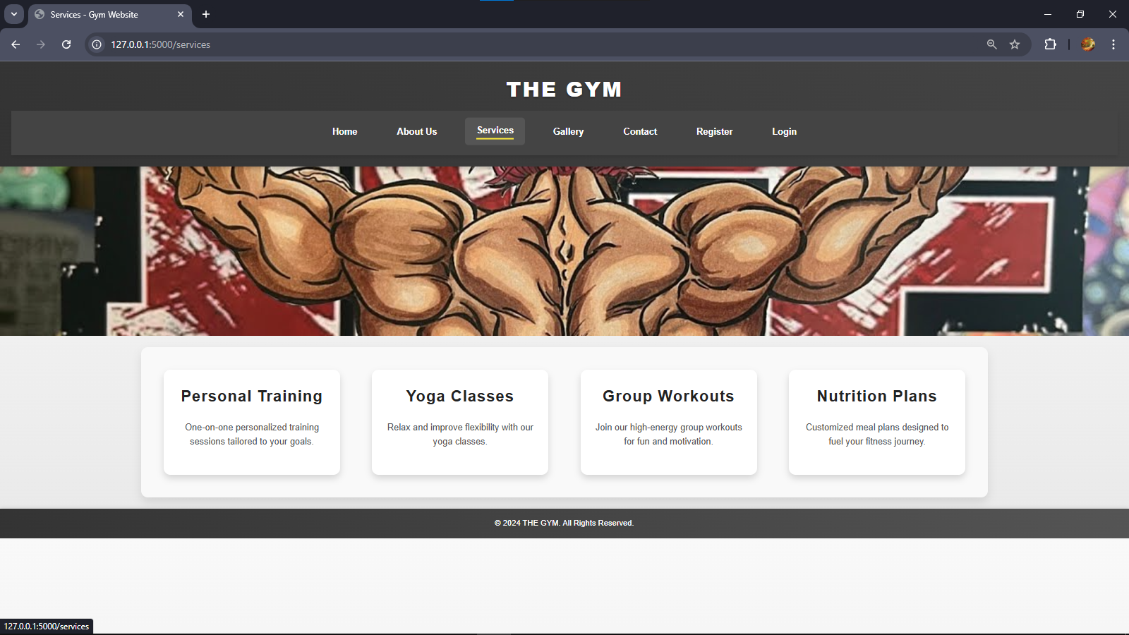
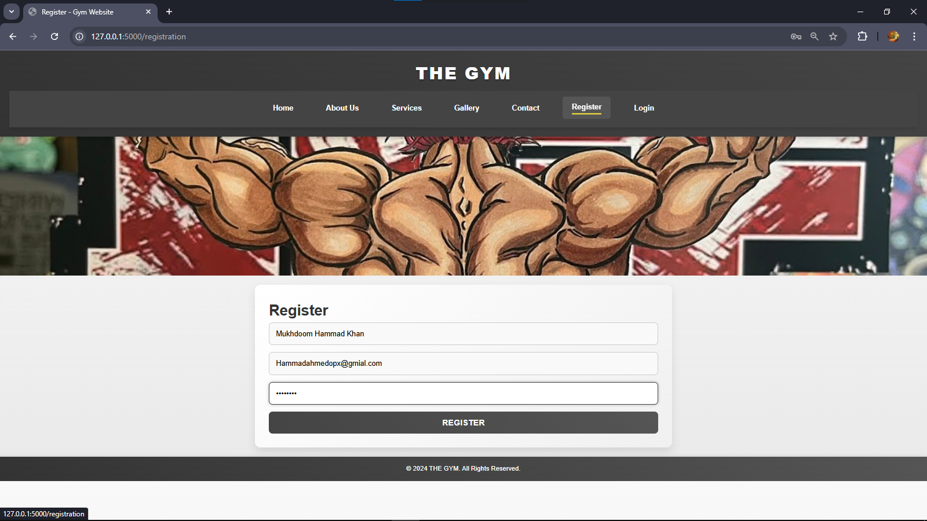
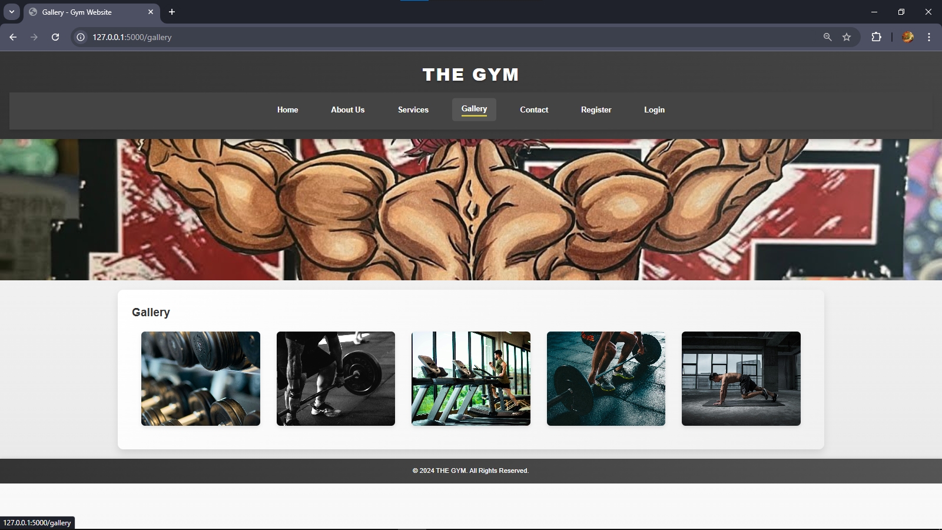
Screenshots – Examples
.

Slide 6
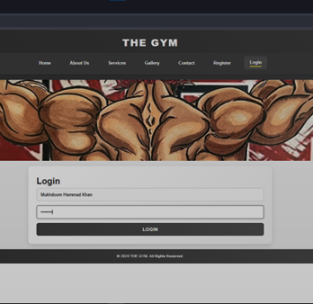
Code Snippets Highlighting Key Sections
- Flask Routes: Example from app.py.
- HTML Forms: Login and registration form code.
- CSS Styling: Responsive design or button hover effects.

Slide 7
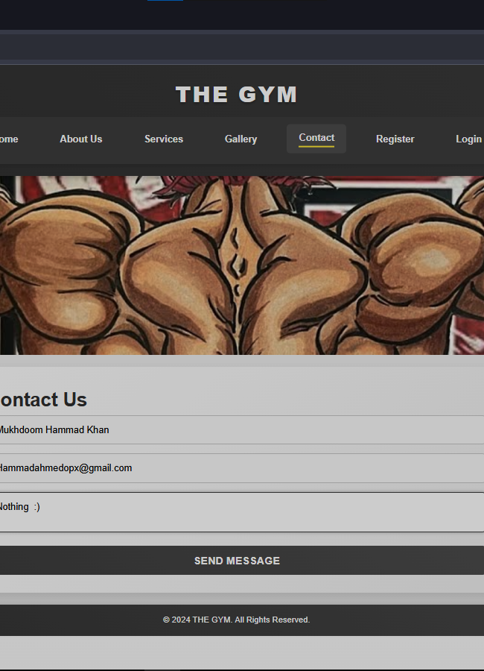
Challenges Faced / Solutions Implemented
Responsive layout: Designed mobile-friendly pages using CSS media queries.
Flask structure: Organized folders and used template inheritance for scalability.
Login simulation: Created smooth login/registration without backend storage.
CSS consistency: Debugged for uniform styling across pages.

